Slide 1


Fatty Liver in Children
What is Fatty Liver?
Fatty liver means there is too much fat stored in the liver. A small amount of fat in the liver is normal, but too much fat can be harmful. It can cause the liver to become swollen and not work properly.
When this happens in children, it is called Pediatric Fatty Liver Disease.
by Ram N Java

Slide 2
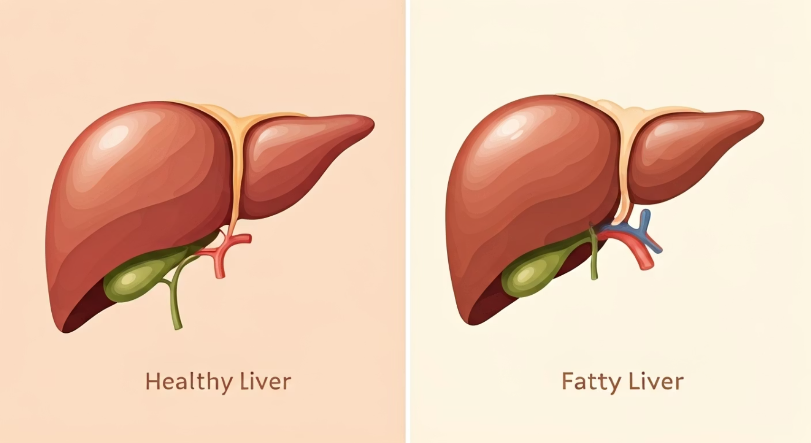
Can Children Get Fatty Liver?
Yes. Fatty liver is not just for adults. Even children can get fatty liver, especially if they are:
Being overweight or obese
Eating too much junk food (sugary drinks, fried foods)
Lack of exercise
Diabetes or high blood sugar
Family history of fatty liver or diabetes
Types of Fatty Liver in Children
Simple Fatty Liver – Fat is present, but the liver is not inflamed.
NASH (Non-Alcoholic Steatohepatitis) – Fat, plus swelling and liver damage.

Slide 3





What are the Signs and Symptoms?
In most cases, fatty liver does not cause symptoms at first. But over time, a child may have:
Stomach pain
Especially on the right side where the liver is located
Tiredness
Feeling more fatigued than usual
Weight gain
Unexplained increase in body weight
Dark skin patches
On the neck or underarms
Liver swelling
Found during check-up

Slide 4

How is it Found?
Doctors may find fatty liver by:
Blood tests
To check liver function
Ultrasound scan
To see fat in the liver
MRI or FibroScan
Sometimes used for more detailed imaging
Liver biopsy
In some cases (rare)

Slide 5
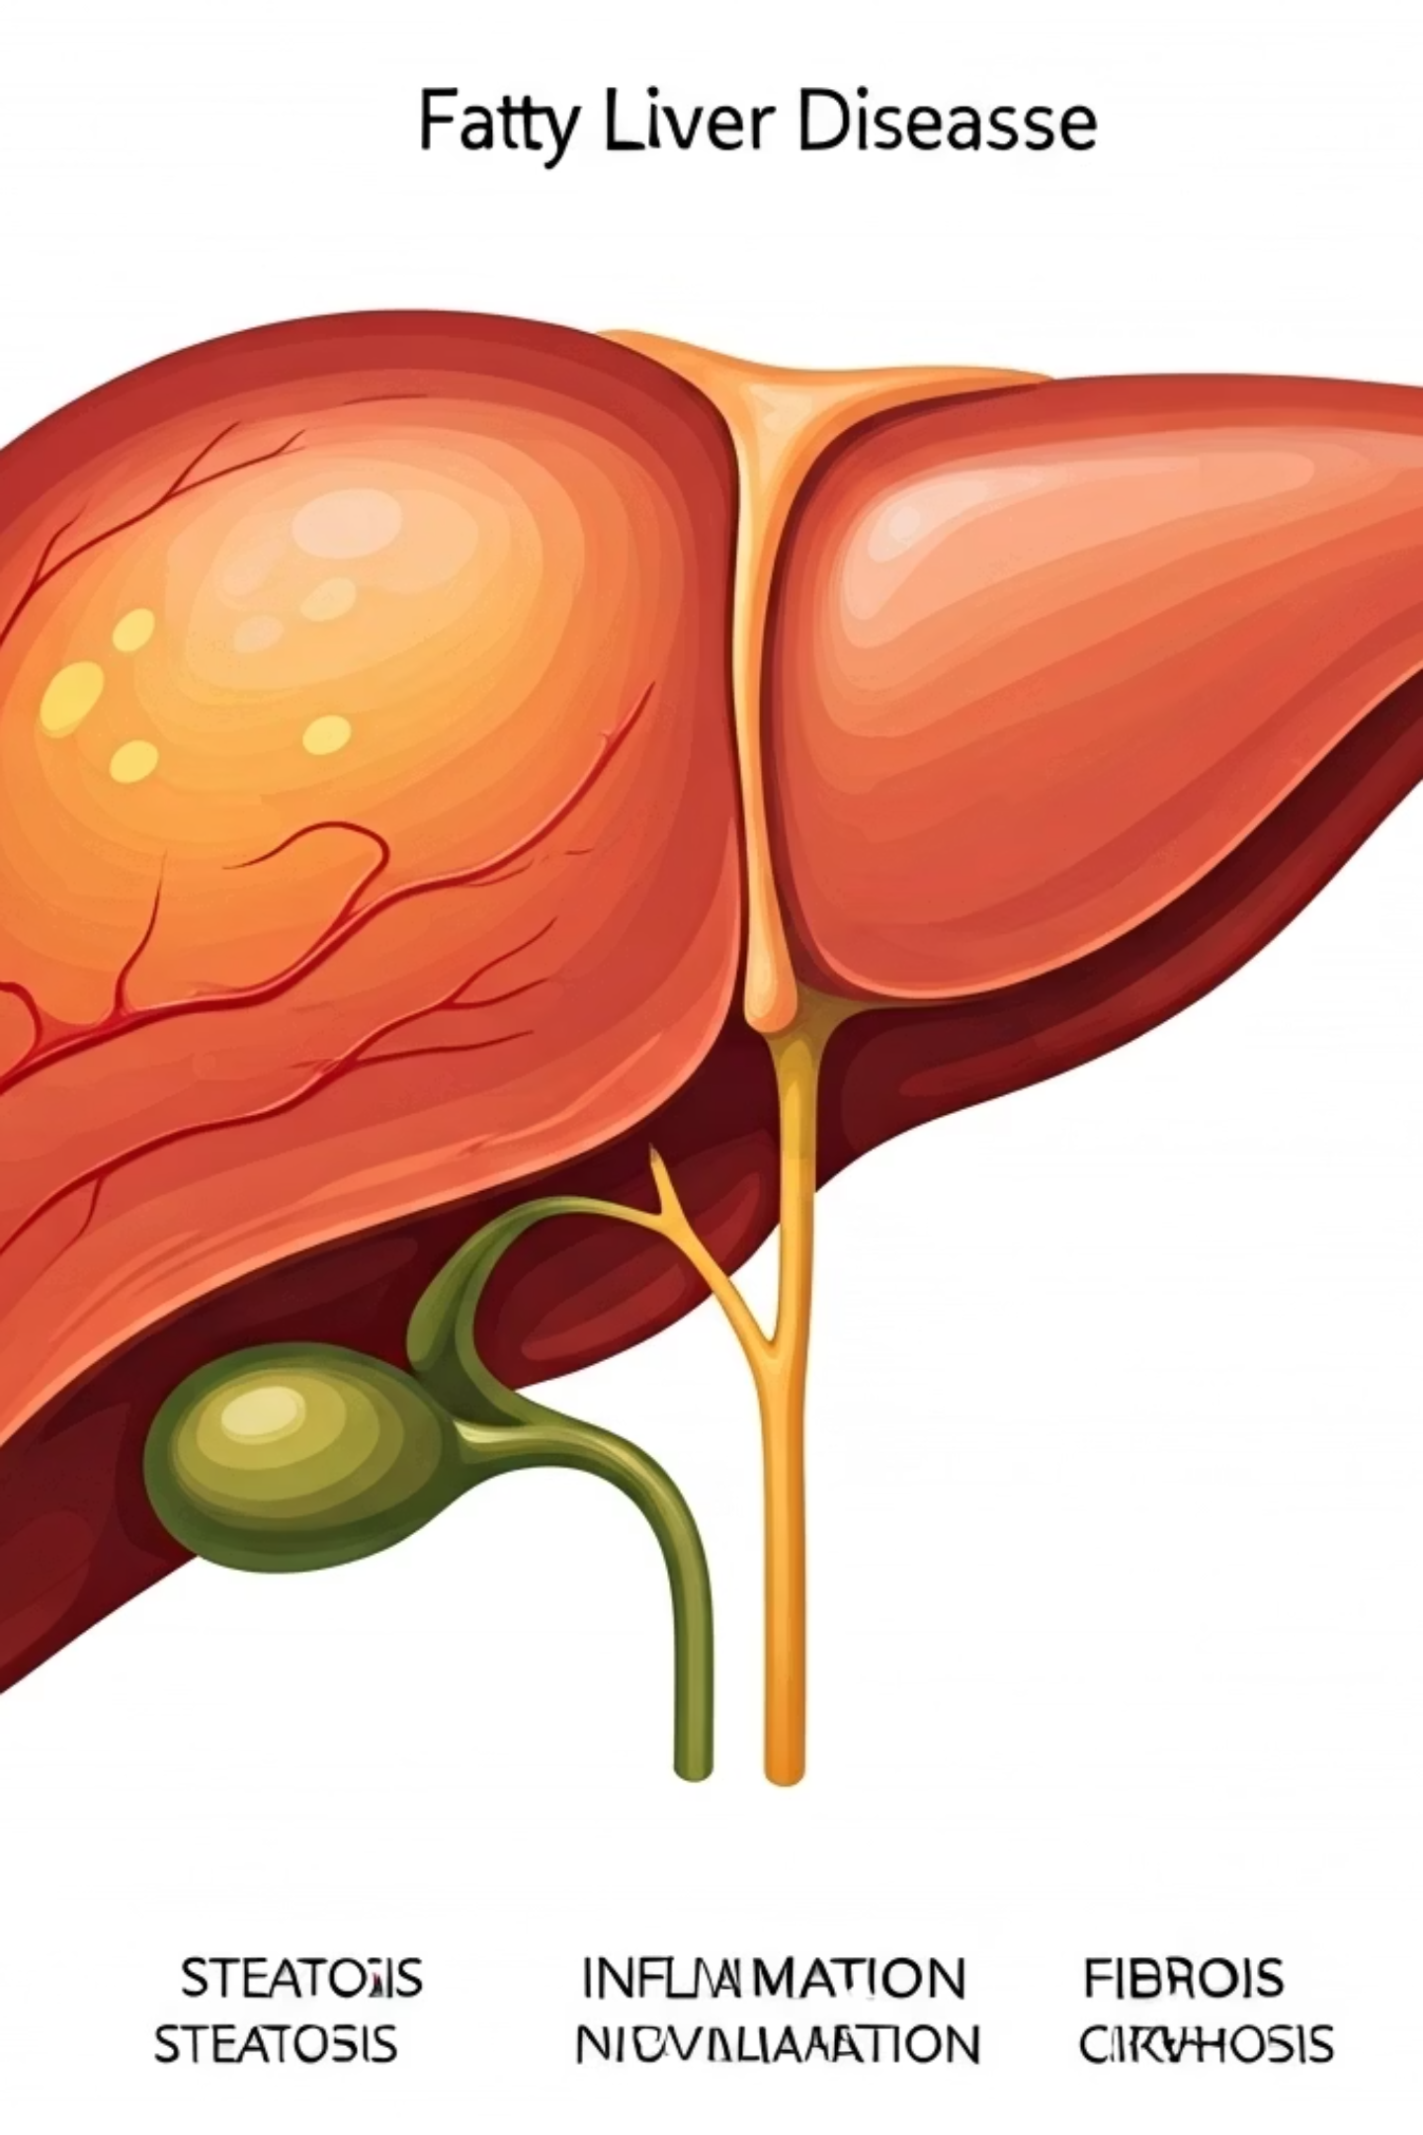




Is it Dangerous?
If not treated, fatty liver can become worse and lead to:
1
Cirrhosis
2
Fibrosis
3
Inflammation
4
Fatty Liver
Liver inflammation - The liver becomes swollen and irritated
Liver scarring (called fibrosis) - Scar tissue begins to form in the liver
Liver damage (cirrhosis) - In very rare and severe cases, permanent damage occurs

Slide 6
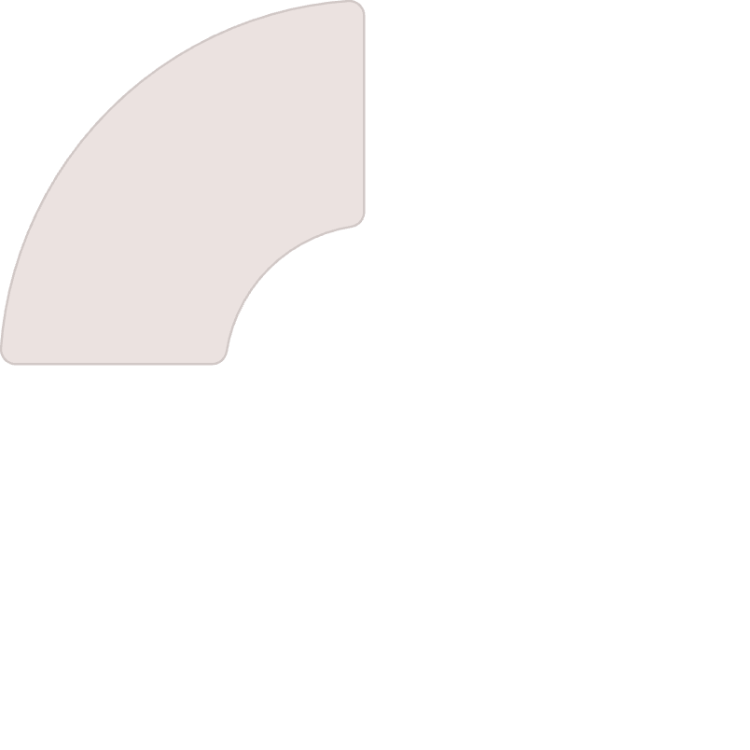
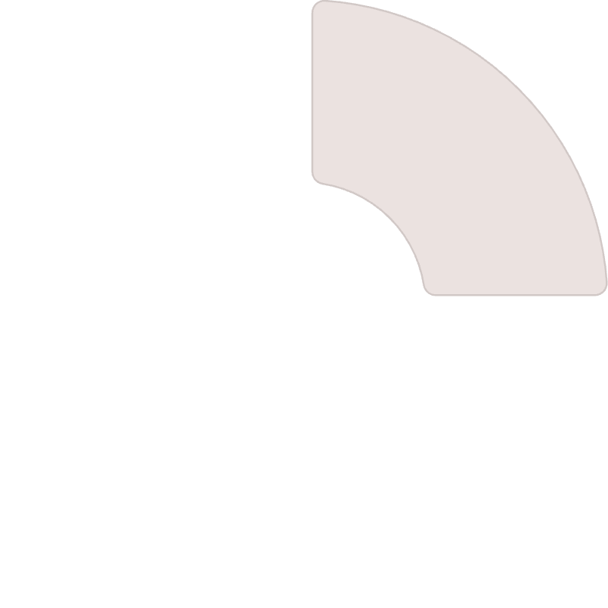

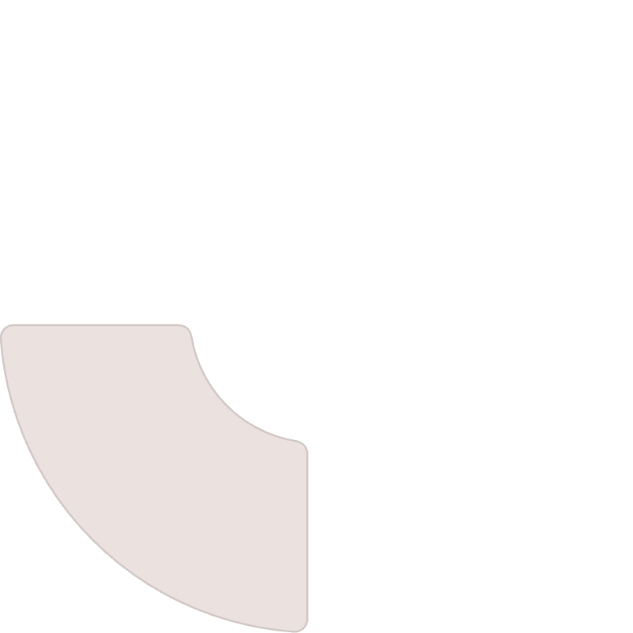









What Causes It in Children?
Diet
Eating too much sugar, oily or fried foods
Activity
Lack of exercise
Heredity
Genetics (family history)
Health
Some medical conditions (like diabetes or thyroid problems)

Slide 7

How Can It Be Treated or Prevented?
There is no special medicine for fatty liver in children. But it can improve with healthy habits:
Healthy Diet
Physical Activity
Eat healthy food: more fruits, vegetables, whole grains
Be active: play, walk, or exercise every day
Avoid junk food: like chips, cold drinks, sweets
Less screen time
Drinking more water
Weight Management
Medical Care
Lose weight safely if overweight (with doctor's guidance)
Regular check-ups with a doctor

Slide 8

How can parents help?
Cook healthy meals at home
Prepare nutritious foods with less fat and sugar
Encourage daily physical activity
Make exercise fun and part of family routine
Avoid sugary drinks and fast food
Limit treats and unhealthy options
Make changes as a family, not just the child
Everyone benefits from healthy habits

Slide 9

Key Points to Remember
Who Gets It
Fatty liver can happen in children too
Main Causes
It is often caused by unhealthy food and no exercise
Treatment
It can be improved by healthy lifestyle changes
Prevention
Early care helps protect the liver from damage

